Slide 1
A Decentralized Scheme for Real-Time Optimization of Traffic Signals
I. Porche, M. Sampath, R. Sengupta,
Y.-L. Chen, and S. Lafortune
Proceedings of the 1996 IEEE International Conference on Control Applications Dearborn, pp. 582-589, 1996
Presenter: Shiuan-Wen Chen
Date: Jan. 18, 2007

Slide 2
ABSTRACT
A real time, highly decentralized, adaptive traffic signal optimization method, ALLONS-D, based on the Rolling Horizon Dynamic Programming technique, is presented in this paper. We describe the basic architecture, the system model, and the optimization scheme of ALLONS-D. We compare ALLONS-D with other approaches to signal control via several sets of simulation results. The margins of improvement are significant when compared with the standard Webster’s criteria for signal setting. The feasibility of on-line implementation of ALLONS-D is discussed as well as on-going evaluations and extensions.

Slide 3
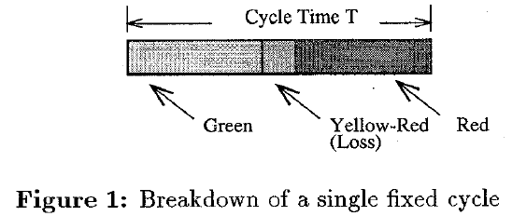
1. Introduction
There are two basic types of control for traffic lights at intersections: fixed-cycle and traffic responsive.
Most of the early traffic-responsive schemes were based on selecting on-line predefined plans from a set of plans generated off-line [l].
In this paper we present ALLONS-D, a real-time traffic responsive strategy for decentralized control of traffic signals.

Slide 4
1. Introduction
ALLONS-D (Adaptive Limited Lookahead Optimization of Network Signals - Decentralized Version) is a decentralized method based on Rolling Horizon Dynamic Programming (RHDP).
Its objective is to minimize the total delay experienced by all network traffic at each intersection in a given network.
RHDP, as a strategy for on-line signal control, has been studied by several transportation researchers, and schemes such as OPAC [2, 61, PRODYN [7], and UTOPIA [8] have been developed and tested.

Slide 5
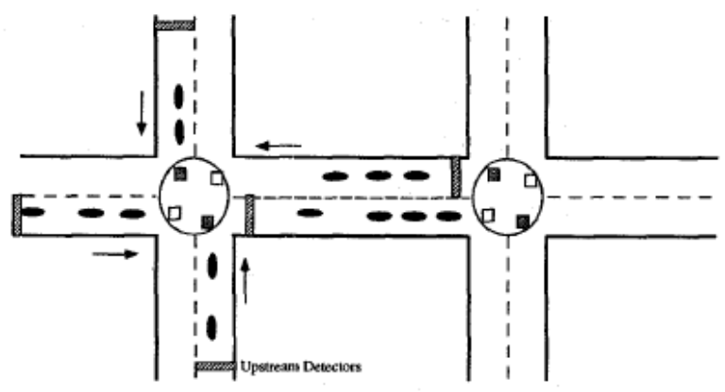
2. Architecture & Optimization Strategy
The ALLONS-D decentralized architecture consists of one signal controller at each intersection of the network which attempts to minimize the aggregate delay at all approaches to that intersection.
Whenever the optimizer recalculates the signal plan, which is at a preset time period denoted by ∆, it takes a snapshot of
the system and collects
arrival information on all
of its approaches.

Slide 6
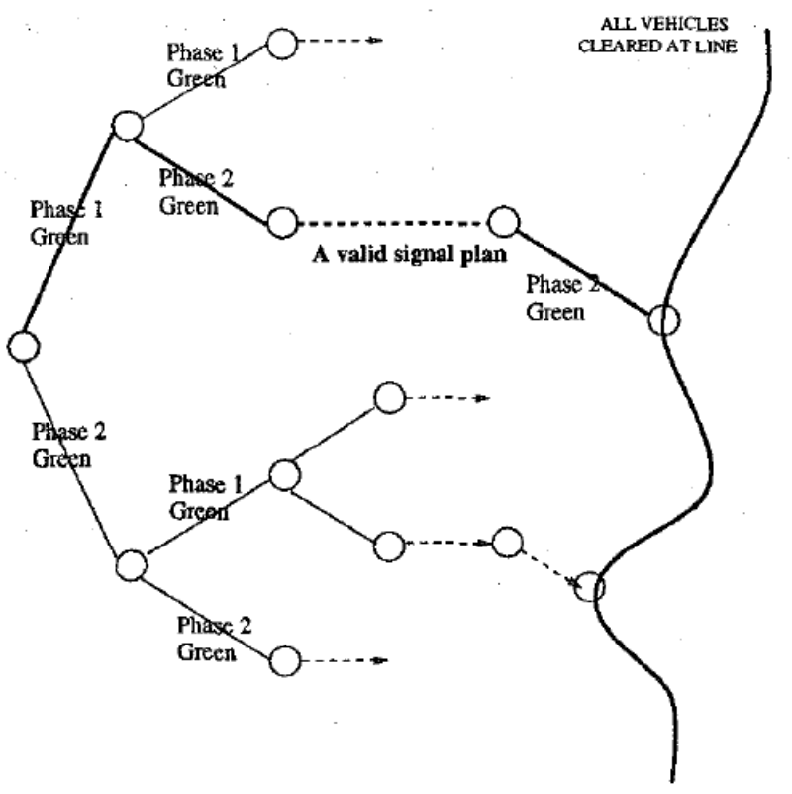
2.1. Decision tree
The decision that the optimizer needs to take at each point in time is to choose the phase to be green.
Assume that whenever green time is allocated to a particular phase, this phase remains green until the next time the controller takes a snapshot of the system at which point a new decision is made.
For a two-phase intersection, the decision space is a binary tree

Slide 7
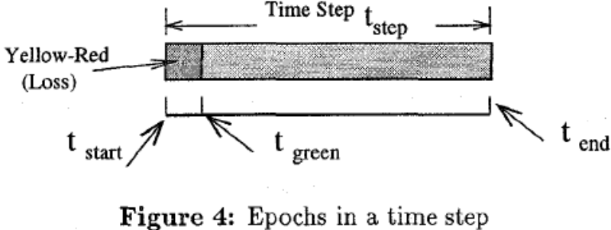
2.1. Decision tree
ALLONS-D is designed to perform a relatively efficient search for an optimal path.
In general, each branch of the tree represents an interval of time that a particular phase will have a green light. This interval is known as a time step (t_{step}).
If a light is continuing green then the time step is the delta time (t_{step} = ∆). If the light has just changed to green then it is the minimum green time plus the yellow-red time ( t_{step} = t_{MG} + t_{YR} )

Slide 8
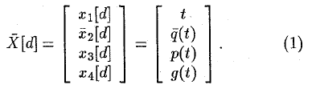

2.2. The System Model
These nodes, shown in Figure 3, represent the state at an intersection.
The state of an intersection is updated by extending the current green phase or changing to another green phase.
This is characterized by the following non-linear state update equation:
the queue sizes on all approaches

Slide 9
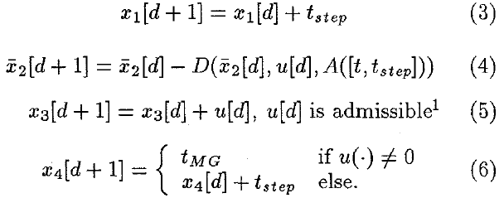
2.2. The System Model
The control variable is u(.). This variable reflects a decision to either change to make another phase p green (u(.) ≠ 0) or to maintain the current phase as green (u(.) = 0) for a duration of time.
The update equations for each state component are as follows:

Slide 10
2.3. Delay Calculations
A cost can be associated with each node along a path.
There are five different contributions to delay:
  (1)
  (2)
  (3)
  (4)
  (5)
For each case, there is a corresponding delay equation.
They can be found in [PL95].

Slide 11
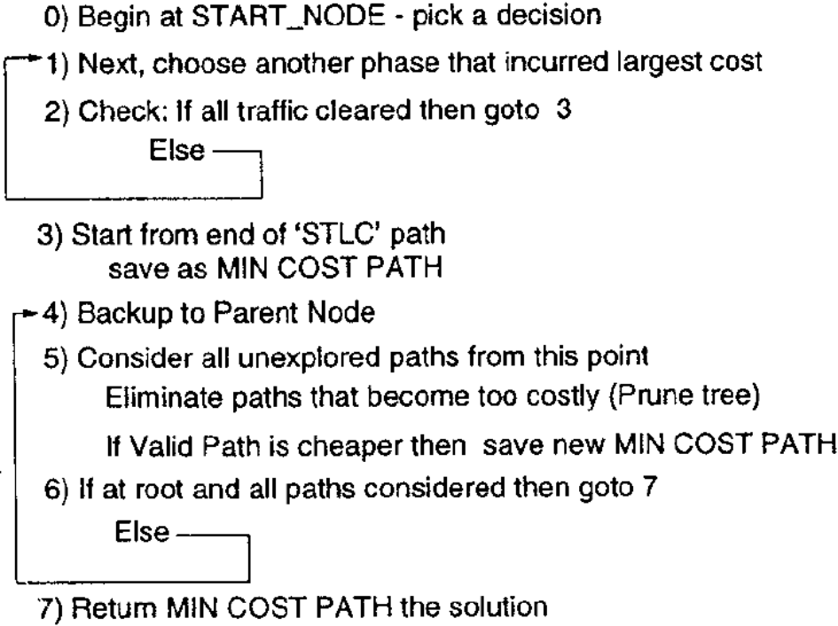
3. ALLONS-D: The Optimization Algorithm
The search of the decision space uses a branch and bound technique and is done in two parts.
The first part is a depth-first search to find an initial path in the tree.
The last part is a backtracking procedure.

Slide 12
3. ALLONS-D: The Optimization Algorithm
As in OPAC, SPPORT [11], and other strategies, signal plans found by ALLONS-D are implemented using the rolling horizon concept.
Once an optimal policy is computed, ALLONS-D implements only the first decision of that policy.
At the end of this time period ALLONS-D updates its arrival information using the most recent detector data, repeats the optimization process over the new decision tree, and computes an optimal policy for the resulting decision tree, and again implements only the first decision.

Slide 13
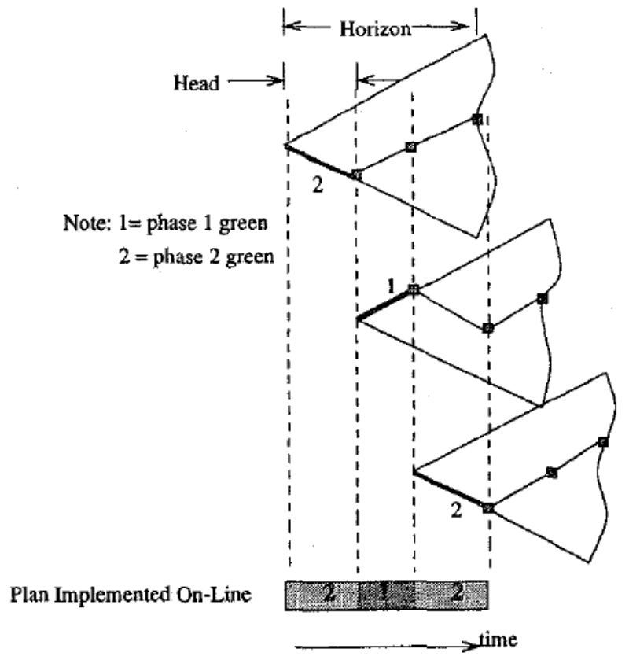
3. ALLONS-D: The Optimization Algorithm
Thus. the horizon is rolled forward one step at a time.

